Slide 1
VISION 3.0 Smart Lock Manager APK Architecture, Design and Implementation
High confidential for NXP Solutions Internal ONLY!
Dongsheng Zhang
Chaosheng Xiang
MARCH 2021

Slide 2
Introduction
High Level Functions:
Feature Based Remote registration:
Do the face data extraction on the mobile phone APK by oasis lite library with phone’s camera
Send the extracted face feature with BLE to vision 3 KIT by BLE
Do the face feature based registration in the vision 3 KIT
Device Management
Password based authentication
Password update
User management
User list preview
User name update
User delete
Hardware Requirements:
QN9090 BLE module connected to vision 3 KIT through the UART
WUART profile in QN9090
Remote Command
Registration Command
Deregistration Command
Preview camera switch Command

Slide 3
KEY Differences WITH vision 2
APK Side:
Background
QN9090 test APK “IoT Box” has the BLE WUART profile implementation(Whole BLE scan/pair/bound/WUART low level communication) which is matched with QN9090 WURAT firmware
Vision 2 FaceRegManage APK has the Camera and Oasis Lite JNI implementation
Add the Device management and User management, remote command for the vision 3 APK
Strategy
Leverage the BLE WUART part in “IoT Box” and the Camera and Oasis Lite JNI part in “FaceRegManager” to build our vision 3 Smart Lock Manager APK
Use the raw data format transmission to reduce the transmission traffic and also the workload to parse/pack the transmission packet at the APK and device side
Add the response for each packet request
VIZN3 Firmware Side:
Redesigned low level UART transmission and remote event handling in vision 3 new framework design
Updated registration flow:
Design the new API in the oasis lite library to handle the registration with the face feature to align the registration flow with local registration(avoid the duplicate registration in the database)
Use the RAW buffer instead of the JSON for the transmission to improve the performance and the memory/workload to parse the raw data from jason

Slide 4
High level architecture --- APK side
APK
UI
Device Scan
Activity
Device
Authentication
Activity
Remote
Registration
Activity
Device
Manager
Activity
User
Manager
Activity
Packet Transmission Protocol
Camera Service
Algorithm Service
BLE Service
CameraManager
CameraDevice
BluetoothAdatper
Bluetooth Device
Algorithm Service
CameraCaptureSession
JNI
BluetoothGattService
CaptureRequest
Surface
OASIS LITE Native library
BluetoothGattCharacteristic
Android Framework
Camera Device
BLE Device
CPU
RAM
GPU

Slide 5
High level architecture --- Device side
Smart Lock Firmware
SLN Framework
SLN HAL
QN9090 Input Device Output Device
Algorithm Manager
Configuration Device
Output Manager
Packet Transmission Protocol
Oasis lite algorithm Device
Input Manager
UI Device
UART Packet Transmission
Display Manager
Display Device
Camera Manager
Camera Device
UART Driver
RT117F BSP
Camera Device
QN9090
M7
UART
FLASH

Slide 6
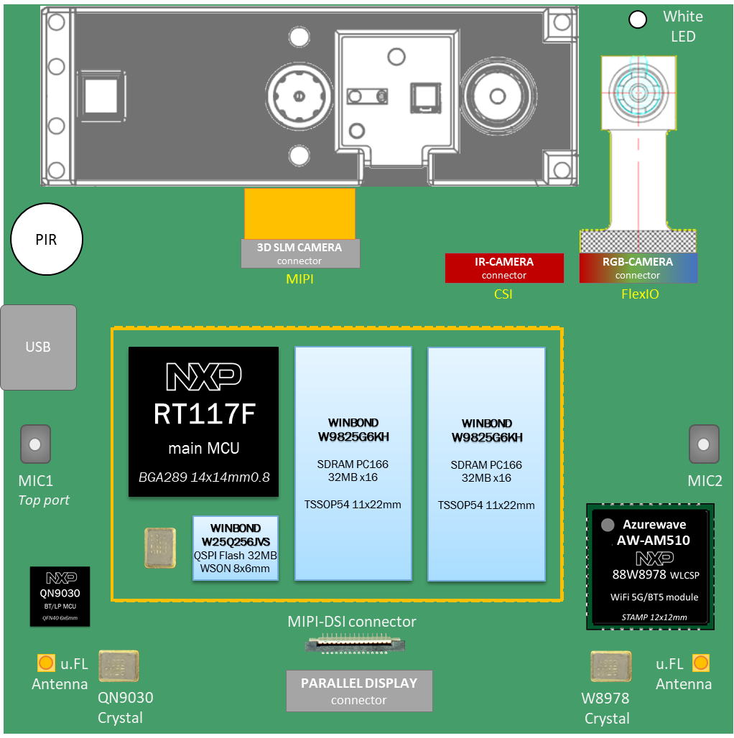
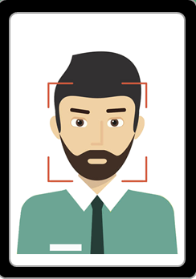
APK AND DEVICE COMMUNICATION process
Scan
Android Phone
Connect
Vision3 KIT
Authenticate
Transmit
Smart Lock Manager APK
Disconnect
Smart Lock Firmware

Slide 7
BLE WUART TRANSMISSION
Transmission Protocol:
All the packet transfer are in raw data format
Each packet transfer will be assembled with header transfer unit with fixed length and the data transfer unit with variable length
VIZN3
APK
Request Packet
Header (fixed length)
Data (variable length)
Transfer Unit Definition:
Response Packet
header transfer unit
Header (fixed length)
1 byte
1 byte
2 bytes
4 bytes
4 bytes
4 bytes
Data (variable length)
tu_type
pkt_type
pkt_len
pkt_id
pkt_crc
tu_crc
data transfer unit
packet data

Slide 8
Packet DEFINITION --- TRANSFER UNIT TYPE AND Packet type
TU Type | Value | Comment
header | 0x79 | Header TU
data | 0x80 | Data TU
Packet Type | Value | Comment | Direction
AUTHENTICATION_REQ | 0 | Authentication request | APK->Device
AUTHENTICATION_RES | 1 | Authentication response | Device->APK
UPDATE_PASSWORD_REQ | 2 | Update password request | APK->Device
UPDATE_PASSWORD_RES | 3 | Update password response | Device->APK
REGISTRATION_REQ | 4 | Remote registration request | APK->Device
REGISTRATION_RES | 5 | Remote registration response | Device->APK
DELETE_USER_REQ | 6 | Remote delete user request | APK->Device
DELETE_USER_RES | 7 | Remote delete user response | Device->APK
GET_USER_COUNT_REQ | 8 | Get user count request | APK->Device
GET_USER_COUNT_RES | 9 | Get user count response | Device->APK
GET_USER_INFO_REQ | 10 | Get user information request | APK->Device
GET_USER_INFO_RES | 11 | Get user information response | Device->APK
UPDATE_USER_INFO_REQ | 12 | Update user information request | APK->Device
UPDATE_USER_INFO_RES | 13 | Update user information response | Device->APK
REGISTRATION_CMD_REQ | 14 | Registration command request | APK->Device
REGISTRATION_CMD_RES | 15 | Registration command response | Device->APK
DEREGISTRATION_CMD_REQ | 16 | Deregistration command request | APK->Device
DEREGISTRATION_CMD_RES | 17 | Deregistration command response | Device->APK
PREVIEWCAMERA_SWITCH_CMD_REQ | 18 | Preview camera switch request | APK->Device
PREVIEWCAMERA_SWITCH_CMD_RES | 19 | Preview camera switch response | Device->APK

Slide 9
Packet DEFINITION --- AUTHENTICATION
AUTHENTICATION_REQ
 | Items | Bytes | Value
Header TU | tu_type | 1 | 0x79
 | pkt_type | 1 | 0
 | pkt_len | 2 | 6
 | pkt_id | 4 | ID of this packet
 | pkt_crc | 4
 | tu_crc | 4
Data TU | password | 6 | Password user typed in
AUTHENTICATION_RES
 | Items | Bytes | Value
Header TU | tu_type | 1 | 0x79
 | pkt_type | 1 | 1
 | pkt_len | 2 | 1
 | pkt_id | 4 | same ID in the REQ
 | pkt_crc | 4
 | tu_crc | 4
Data TU | Authentication status | 1 | 0: success other: error code

Slide 10
Packet DEFINITION --- UPDATEPASSWORD
UPDATEPASSWORD_REQ
 | Items | Bytes | Value
Header TU | tu_type | 1 | 0x79
 | pkt_type | 1 | 2
 | pkt_len | 2 | 6
 | pkt_id | 4 | ID of this packet
 | pkt_crc | 4
 | tu_crc | 4
Data TU | password | 6 | New password
UPDATEPASSWORD_RES
 | Items | Bytes | Value
Header TU | tu_type | 1 | 0x79
 | pkt_type | 1 | 3
 | pkt_len | 2 | 1
 | pkt_id | 4 | same ID in the REQ
 | pkt_crc | 4
 | tu_crc | 4
Data TU | Password update status | 1 | 0: success other: error code

Slide 11
Packet DEFINITION --- REGISTRATION
REGISTRATION_REQ
 | Items | Bytes | Value
Header TU | tu_type | 1 | 0x79
 | pkt_type | 1 | 4
 | pkt_len | 2 | 432
 | pkt_id | 4 | ID of this packet
 | pkt_crc | 4
 | tu_crc | 4
Data TU | name | 32 | User name
 | Face data | 400 | Face data
REGISTRATION_RES
 | Items | Bytes | Value
Header TU | tu_type | 1 | 0x79
 | pkt_type | 1 | 5
 | pkt_len | 2 | 1
 | pkt_id | 4 | same ID in the REQ
 | pkt_crc | 4
 | tu_crc | 4
Data TU | Registration status | 1 | 0: success 1: duplicate registration Other: error code

Slide 12
Packet DEFINITION --- registration apk side:
Extract the
face data with oasis
lite
Send Task
RGB frame
GRAY88 frame
Face
data
Assembly the
Packet
Low
level
BLE
uart
send
receive
Collect the user name
Face
Name
Send Packet
Camera
Receive Task
Registration
Result Feedback
Receive Packet
Parse Packet

Slide 13
Packet DEFINITION --- registration device side:
BLE UART
Algorithm
Outputs
BLE task
Input device:
ble uart
Input notify:
Remote registration
event
Valgo device:
oasis lite
Output device:
ui
input_notity()
input_notity()
Low
level
BLE
uart
send
receive
Remote
registration
Packet
input_notity()
Remote registration
Output device:
console
Remote
registration
Response
Packet
Output device:
ble uart
input_notity()
input_notity()
Valgo result update:
Remote registration
mode result

Slide 14
Packet DEFINITION --- DELETE_USER
DELETE_USER_REQ
 | Items | Bytes | Value
Header TU | tu_type | 1 | 0x79
 | pkt_type | 1 | 6
 | pkt_len | 2 | 4
 | pkt_id | 4 | ID of this packet
 | pkt_crc | 4
 | tu_crc | 4
Data TU | Face id | 4 | Unique face id
DELETE_USER_RES
 | Items | Bytes | Value
Header TU | tu_type | 1 | 0x79
 | pkt_type | 1 | 7
 | pkt_len | 2 | 1
 | pkt_id | 4 | same ID in the REQ
 | pkt_crc | 4
 | tu_crc | 4
Data TU | Delete user status | 1 | 0: success Other: error code

Slide 15
Packet DEFINITION --- GET_USER_COUNT
GET_USER_COUNT_REQ
 | Items | Bytes | Value
Header TU | tu_type | 1 | 0x79
 | pkt_type | 1 | 8
 | pkt_len | 2 | 0
 | pkt_id | 4 | ID of this packet
 | pkt_crc | 4
 | tu_crc | 4
Data TU | None
GET_USER_COUNT_RES
 | Items | Bytes | Value
Header TU | tu_type | 1 | 0x79
 | pkt_type | 1 | 9
 | pkt_len | 2 | 4
 | pkt_id | 4 | same ID in the REQ
 | pkt_crc | 4
 | tu_crc | 4
Data TU | User count | 4 | User count

Slide 16
Packet DEFINITION --- GET_USER_INFO
GET_USER_INFO_REQ
 | Items | Bytes | Value
Header TU | tu_type | 1 | 0x79
 | pkt_type | 1 | 10
 | pkt_len | 2 | 0
 | pkt_id | 4 | ID of this packet
 | pkt_crc | 4
 | tu_crc | 4
Data TU | None
GET_USER_INFO_RES
 | Items | Bytes | Value
Header TU | tu_type | 1 | 0x79
 | pkt_type | 1 | 11
 | pkt_len | 2 | 36
 | pkt_id | 4 | same ID in the REQ
 | pkt_crc | 4
 | tu_crc | 4
Data TU | User ID | 4 | User ID
 | User Name | 32 | User name

Slide 17
Packet DEFINITION --- update_USER_INFO
UPDATE_USER_INFO_REQ
 | Items | Bytes | Value
Header TU | tu_type | 1 | 0x79
 | pkt_type | 1 | 12
 | pkt_len | 2 | 0
 | pkt_id | 4 | ID of this packet
 | pkt_crc | 4
 | tu_crc | 4
Data TU | User ID | 4 | The ID of the user to be updated
 | User Name | 32 | The new name to update
UPDATE_USER_INFO_RES
 | Items | Bytes | Value
Header TU | tu_type | 1 | 0x79
 | pkt_type | 1 | 13
 | pkt_len | 2 | 36
 | pkt_id | 4 | same ID in the REQ
 | pkt_crc | 4
 | tu_crc | 4
Data TU | Update status | 1 | 0:success Other: error code

Slide 18
Packet DEFINITION --- registration_cmd
REGISTRATION_CMD_REQ
 | Items | Bytes | Value
Header TU | tu_type | 1 | 0x79
 | pkt_type | 1 | 14
 | pkt_len | 2 | 0
 | pkt_id | 4 | ID of this packet
 | pkt_crc | 4
 | tu_crc | 4
Data TU | None
REGISTRATION_CMD_RES
 | Items | Bytes | Value
Header TU | tu_type | 1 | 0x79
 | pkt_type | 1 | 15
 | pkt_len | 2 | 1
 | pkt_id | 4 | same ID in the REQ
 | pkt_crc | 4
 | tu_crc | 4
Data TU | Send command status | 1 | 0: command send success Other: error code

Slide 19
Packet DEFINITION --- deregistration_cmd
DEREGISTRATION_CMD_REQ
 | Items | Bytes | Value
Header TU | tu_type | 1 | 0x79
 | pkt_type | 1 | 16
 | pkt_len | 2 | 0
 | pkt_id | 4 | ID of this packet
 | pkt_crc | 4
 | tu_crc | 4
Data TU | None
DEREGISTRATION_CMD_RES
 | Items | Bytes | Value
Header TU | tu_type | 1 | 0x79
 | pkt_type | 1 | 17
 | pkt_len | 2 | 1
 | pkt_id | 4 | same ID in the REQ
 | pkt_crc | 4
 | tu_crc | 4
Data TU | Send command status | 1 | 0: command send success Other: error code

Slide 20
Packet DEFINITION --- PREVIEWCAMERA_SWITCH_cmd
PREVIEWCAMER_SWITCH_CMD_REQ
 | Items | Bytes | Value
Header TU | tu_type | 1 | 0x79
 | pkt_type | 1 | 18
 | pkt_len | 2 | 0
 | pkt_id | 4 | ID of this packet
 | pkt_crc | 4
 | tu_crc | 4
Data TU | None
PREVIEWCAMERA_SWITCH_CMD_RES
 | Items | Bytes | Value
Header TU | tu_type | 1 | 0x79
 | pkt_type | 1 | 19
 | pkt_len | 2 | 1
 | pkt_id | 4 | same ID in the REQ
 | pkt_crc | 4
 | tu_crc | 4
Data TU | Send command status | 1 | 0: command send success Other: error code

Slide 21
APK ui flow
Smart Lock Manager
Scan
Smart Lock Manager
Connected
Smart Lock Manager
Connected
Smart Lock Manager
Connected
Scan
VIZN3
Registration
Reg Confirm
VIZN3
Authenti
cation
Registra
tion
Change Password
User
Manger
Remote
Command
Name:
Sending/Finished/Failed
Start
Cancel
Ok
Smart Lock Manager
Authentication
Smart Lock Manager
…
Delete
Remote Command
Connected
User Manager
ID:
1
Registration
Password:
0 : Dongsheng Zhang
Name:
Chaosheng Xiang
Cancel
Ok
1 : Chaosheng Xiang
Cancel
Ok
Deregistration
…
Preview Camera Switch
Change Password
Update
Old:
ID:
0
New:
Name:
Chaosheng Xiang
Cancel
Ok
Cancel
Ok

